Slide 1














CSSC Initiative:
S
C _{S}C
Lab Hazard Signage Standardization
The Issue: Inconsistent lab signage makes hazard identification diffi cult and time-consuming for researchers or visitors
Our Solution: Create a standardized system of hazard signs for the entire department, customized for individual labs, and created by CSSC to ensure consistency and visibility.
This Facility Has Hazardous/Toxic Chemicals In Use And In Storage With Additional Hazardous Physical Agents Present in Equipment
NFPA Hazard Class: C
Max Flammable Storage: 24 Gal
Banerjee Laboratory
Specific Requirements for lab entry, including PPE, are clearly visible to anyone before entering lab space
Entry Requirements
Hazards
Present Hazards are clearly labeled and combined in one place for easy identification
Safey attire (lab coat and long pants, closed-toe shoes) and lab safety glasses to be worn at all times.
No gloves on doors Keep doors closed
Special Hazards
Special Hazards are labeled separately and additional information is included as necessary
Laser,Bio,Radiation
Up to date contact information increases acountability and ensures rapid response in case of emergency
Contacts
PI: Dr. Sarbajit Banerjee Phone: +1-(979)-862-3102
Email: banerjee@chem.tamu.edu
Contact information:
Name: Phone: Name: Phone:
(final design TBD)

Slide 2
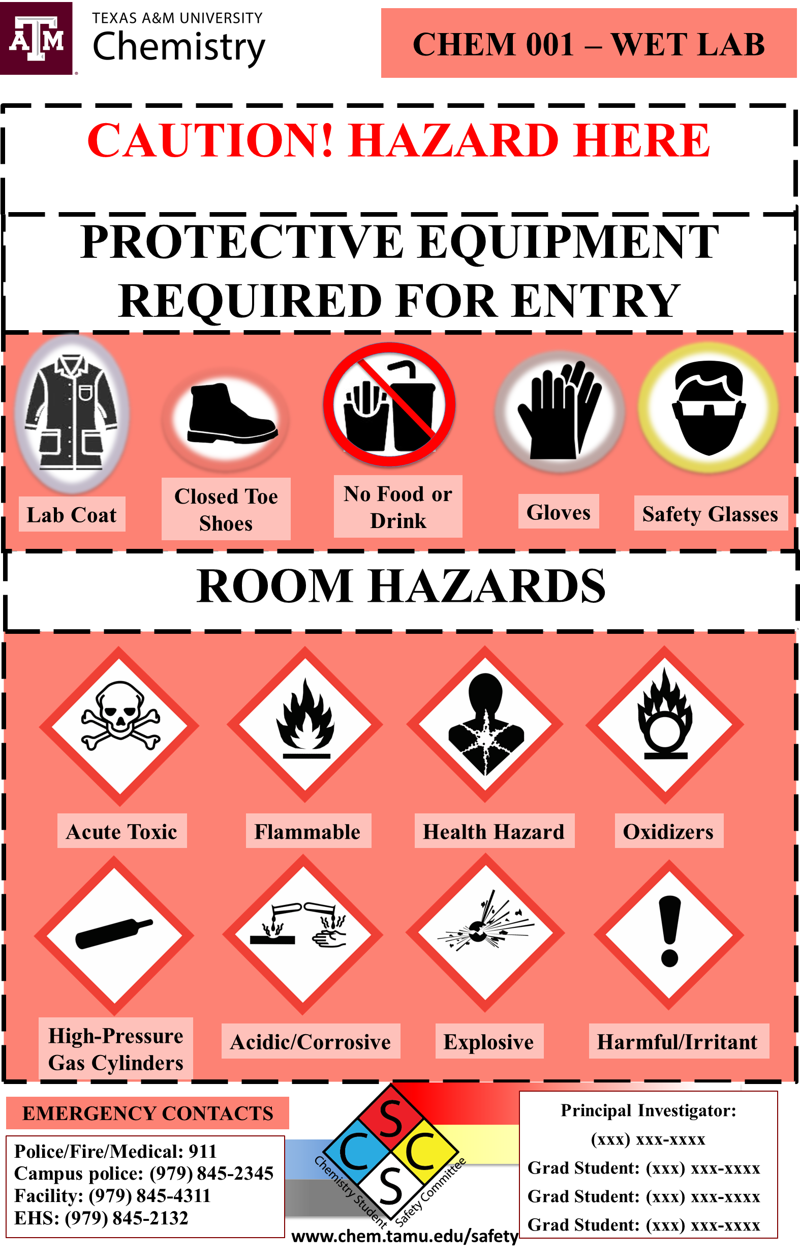
Instructions/Tips
Fill out one template per lab. Red templates are for wet labs, blue for instrument labs, green for teaching labs, and yellow for biological labs. For labs with multiple doors, duplicate the slide to have one slide per door
When finished, delete all unneeded slides and email back to CSSC@chem.tamu.edu with your group included in the file name and email. The CSSC will print the first round of door signs and distribute them. Future signs should be printed on 11 x 17 paper.
For unique lab circumstances or any other questions, please send us an email and we will help you figure it out.
Only change room number
Primary Lab Hazards
(ex: Hazardous Chemicals, Biohazards, Lasers Present, High Voltage Equipment, Strong Magnetic Fields, Radiation Sources, etc.)
Show only PPE needed for entry for this lab
Comprehensive Hazard List
(copy/paste from hazard slide)
Lab contacts

Slide 3


CHEM 001 – WET LAB
CAUTION! PRIMARY HAZARD
PROTECTIVE EQUIPMENT REQUIRED FOR ENTRY
Lab Coat
Closed Toe Shoes
No Food or Drink
Gloves
Safety Glasses
ROOM HAZARDS
EMERGENCY CONTACTS
Principal Investigator:
(xxx) xxx-xxxx
Grad Student: (xxx) xxx-xxxx
Grad Student: (xxx) xxx-xxxx
Grad Student: (xxx) xxx-xxxx
Police/Fire/Medical: 911
Campus police: (979) 845-2345
Facilities: (979) 845-4311
EHS: (979) 862-1111
chem.tamu.edu/safety
Frame funding graciously provided by Texas A&M EH&S

Slide 4
CHEM 001 – INSTRUMENT LAB
CAUTION! PRIMARY HAZARD
PROTECTIVE EQUIPMENT REQUIRED FOR ENTRY
Lab Coat
Closed Toe Shoes
No Food or Drink
Gloves
Safety Glasses
ROOM HAZARDS
EMERGENCY CONTACTS
Principal Investigator:
(xxx) xxx-xxxx
Grad Student: (xxx) xxx-xxxx
Grad Student: (xxx) xxx-xxxx
Grad Student: (xxx) xxx-xxxx
Police/Fire/Medical: 911
Campus police: (979) 845-2345
Facilities: (979) 845-4311
EHS: (979) 862-1111
chem.tamu.edu/safety
Frame funding graciously provided by Texas A&M EH&S

Slide 5
CHEM 001 – TEACHING LAB
CAUTION! PRIMARY HAZARD
PROTECTIVE EQUIPMENT REQUIRED FOR ENTRY
Lab Coat
Closed Toe Shoes
No Food or Drink
Gloves
Safety Glasses
ROOM HAZARDS
EMERGENCY CONTACTS
Principal Investigator:
(xxx) xxx-xxxx
Grad Student: (xxx) xxx-xxxx
Grad Student: (xxx) xxx-xxxx
Grad Student: (xxx) xxx-xxxx
Police/Fire/Medical: 911
Campus police: (979) 845-2345
Facilities: (979) 845-4311
EHS: (979) 862-1111
chem.tamu.edu/safety
Frame funding graciously provided by Texas A&M EH&S

Slide 6
CHEM 001 – BIOLOGICAL LAB
CAUTION! PRIMARY HAZARD
PROTECTIVE EQUIPMENT REQUIRED FOR ENTRY
Lab Coat
Closed Toe Shoes
No Food or Drink
Gloves
Safety Glasses
ROOM HAZARDS
EMERGENCY CONTACTS
Principal Investigator:
(xxx) xxx-xxxx
Grad Student: (xxx) xxx-xxxx
Grad Student: (xxx) xxx-xxxx
Grad Student: (xxx) xxx-xxxx
Police/Fire/Medical: 911
Campus police: (979) 845-2345
Facilities: (979) 845-4311
EHS: (979) 862-1111
chem.tamu.edu/safety
Frame funding graciously provided by Texas A&M EH&S

Slide 7
PPE Symbols
Lab Coat
Closed Toe Shoes
No Food or Drink
Gloves
Safety Glasses
Sleeved Shirt
Full Length Pants
No Gloves

Slide 8
Hazard Symbols
Biological Hazard
Toxic Hazard
Flammable
Health Hazard
Oxidizer
Acidic/Corrosive
Explosive
Laser Source
High-Pressure
Gas Cylinders
Harmful/Irritant
Radiation Source
High Voltage Source
Magnetic Field
Environmental Hazard

